Slide 1

UCB - CS189 Introduction to Machine Learning Fall 2015 Lecture 15: Gaussian Processes
Last lecture
Isabelle Guyon
ChaLearn

Slide 2

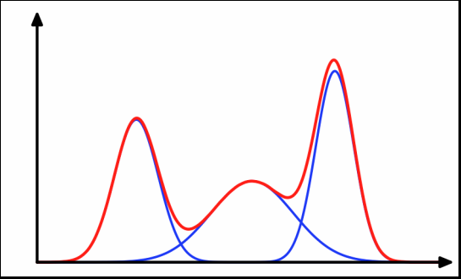
Come to my office hours… Wed 2:30-4:30 Soda 329
Last time: Mixture models

Slide 3
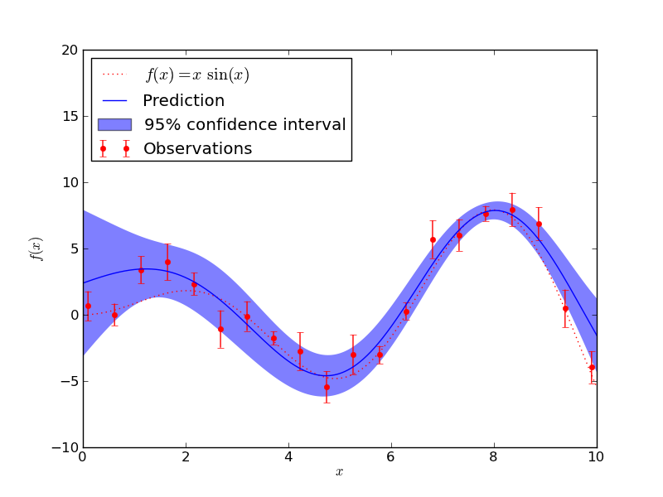
Come to my office hours… Wed 2:30-4:30 Soda 329
Today: Gaussian processes

Slide 4





Data generating models P(X, Y) = P(X)P(Y|X) = P(Y)P(X|Y)
Review
P(X)
5
P(Y)
P(X|Y)
P(Y|X)
96 98 78 6 63 79…

Slide 5




Discriminative models f(x) = ( Σ_{k} α_{k} [Φ(x^{k}) ) • Φ(x) ]
Review
P(Y|X)
w
k(x^{k}, x; θ)
Algorithm:
Hebb’s rule
w = Σ_{k=1:N} y^{k}x^{k}
w = X^{T}y
Parzen windows
α_{k =} y_{k}
Any k(x^{k}, x; θ)
θ fitted to R_{CV}
f(x)=Σ_{k} α_{k} k(x^{k}, x ; θ)
“Perceptrons”
α_{k} fitted to R_{train}
k(x^{k}, x) = x^{k} • x
No θ
f(x) = w • x
Kernel methods
α_{k} fitted to R_{train}
Any k(x^{k}, x; θ)
θ fitted to R_{CV}
f(x)=Σ_{k} α_{k} k(x^{k}, x ; θ)
Hebb’s method
α_{k =} y_{k}
k(x^{k}, x) = x^{k} • x
No θ
f(x) = w • x
Algorithms:
SVM
Logistic regression
Ridge regression
w = X⁺y = Σ⁻¹ X^{T}y

Slide 6

Generative models
Review
Today
P(X|Y)
Algorithm:
Centroid
w =Σ_{k} y^{k}x^{k} = X^{T}y
y^{k}∈{+1/N₁, -1/N₀}
w= μ^{[1]}– μ^{[0]}
LDA
Mixture models
Gaussian
processes
Algorithm:
w= Σ⁻¹(μ^{[1]}– μ^{[0]})
Σ = X^{T}X+λΙ, λ>0
w = Σ⁻¹ X^{T}y
y^{k}∈{+1/N₁, -1/N₀}
Naïve Bayes
Last time

Slide 7



Wrong assumptions don’t really matter!
Review
f(x)
Variance
E_{D}f(x)
Bias²
y target
Bias vs. variance tradeoff
E_{D}[f(x)-y]² = [E_{D}f(x)-y]² + E_{D}[f(x)-E_{D}f(x)]²
Increasing complexity
C
Structural risk minimization
R[f] ≤ R_{emp}[f] + ε(δ, C/N)
S₃
S₂
S₁
Bias is “good”,
if lowering C helps you get better generalization error
Notes:
E_{D}f(x,D) is the aggregated learning machine

Slide 8
Mixture models
x₂
y
x₁
f(x) = Σ_{k=1:Nc} α_{k} k(μ^{k}, x; σ) + b

Slide 9

Gaussian mixtures
Review
x₂
k(x^{k}, x) = exp(-ǁx-x_{k}ǁ²/2σ²)
Gaussian kernel
y
Gaussian classifier: N_{c} = 2 (one per class)
Parzen windows: N_{c} = N (one per example)
x₁

Slide 10
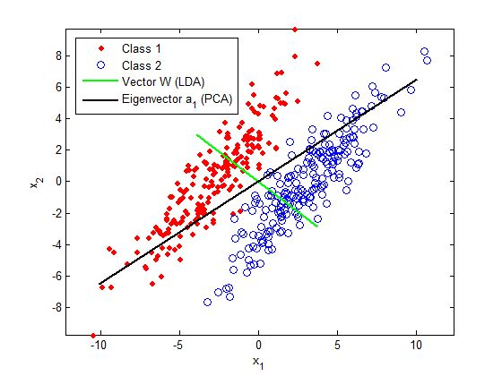

How to “kernelize” PCA and LDA?
Source: www.intechopen.com
Apply whitening in both case to get Ξ = X Σ^{-1/2}
PCA: Σ is the TOTAL covariance matrix.
LDA: Σ is the POOLED WITHIN CLASS covariance matrix.

Slide 11

Σ⁻¹ for BIG data
X^{T}X dim(d,d)
XX^{T} dim(N,N)
which one do I rather invert?
Singular value decomposition:
X=VSU^{T}, with U^{T}U=1 and V^{T}V=1
S diagonal dim(r, r): singular values, r = rank(X)≤min(d,N)
X^{T}X=US²U^{T} and XX^{T}=VS²V^{T} dim(U)=(d, r) dim(V)=(N, r)
cheap Ξ = XU, Σ^{1/2} = USU^{T}, Σ⁻¹ = US⁻²U^{T}, etc.
r is small + keep only largest singular values.
Kernel trick:
d>>N → XX^{T} = VS²V^{T} XX^{T} → K (kernel trick)
Instead of Ξ = XU use Ξ = VS, much cheaper!
Ξ_{new} = X_{new} U? X=VSU^{T} so U = X^{T}VS⁻¹
Ξ_{new} = X_{new} X^{T}VS⁻¹ X_{new} X^{T}→ [k(x^{h}, x^{k})] (kernel trick)

Slide 12
Parameter estimation
Maximum likelihood (ML):
Param = argmax(P(data|model))
Examples:
μ^{[y]}=Σ_{xk∈y} x^{k}
Maximum A Posteriori (MAP):
Param = argmax(P(model|data))
= argmax(P(data|model)P(model))
likelihood
σ_{ij} = (1/N) Σ_{k=1:N} (x_{i}^{k}- μ_{i})(x_{j}^{k}- μ_{j})
posterior
likelihood
prior

Slide 13
Bayesian MAP ≅ SRM
Maximum A Posteriori (MAP):
f = argmax P(f|D)
= argmax P(D|f) P(f)
= argmin –log P(D|f) –log P(f)
Structural Risk Minimization (SRM):
f = argmin R_{emp}[f] + Ω[f]
Negative log likelihood = Empirical risk R_{emp}[f]
Negative log prior = Regularizer Ω[f]
Notes:
MAP=maximum a posteriori
RRM=regularized risk minimization

Slide 14
Example: Ridge regression a.k.a. Gaussian processes
Structural Risk Minimization (SRM):
w = argmin_{w} ǁ y - X w^{T} ǁ² + λ ǁ w ǁ²
Maximum A Posteriori (MAP):
w = argmin_{w} –log P(D|f) –log P(f)
= argmax_{w} P(D|f) P(f)
= argmax_{w} exp(- ǁ y - X w^{T} ǁ²) exp(-λ ǁ w ǁ² )
= argmax_{w} exp(-ǁy - X w^{T}ǁ²) exp(-ǁ w ǁ² /2σ²)
Negative log likelihood
Negative log prior
Notes:
MAP=maximum a posteriori
RRM=regularized risk minimization

Slide 15
Bayesian “learning”
Remember the idea of ensembles:
Do not select a model, “vote” on all possible models according to their “performance”.
Replace:
w = argmax_{w} exp(-ǁy - X w^{T}ǁ²) exp(-ǁ w ǁ² /2σ²)
f(x) = w x^{T} ~P(w|data)
by
P(y|x) = ∫_{w} P(y|x, w) P(w|data) dw
Notes:
MAP=maximum a posteriori
RRM=regularized risk minimization

Slide 16
Generative model
Gaussian
noise
w
f_{w}(x)
y = f_{w}(x) + noise ~ P(Y=y|X=x)
P(w)
f_{w}

Slide 17
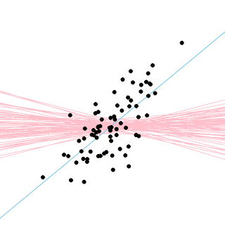
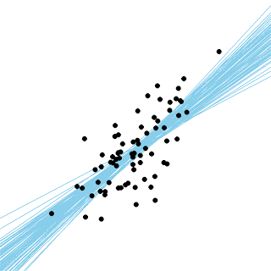
Linear Gaussian Processes
y
y
x
Blue: frequentist regression
Red: prior on w
x
Blue: Bayesian regression
http://doingbayesiandataanalysis.blogspot.com/2013_12_01_archive.html

Slide 18
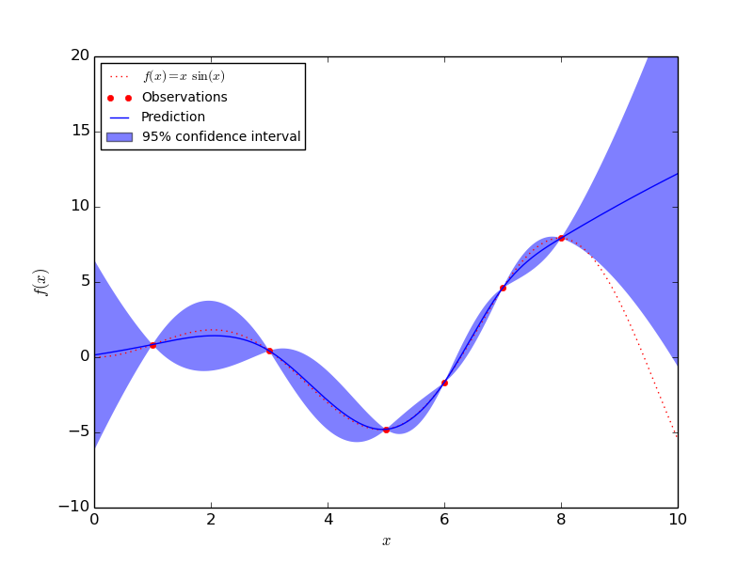
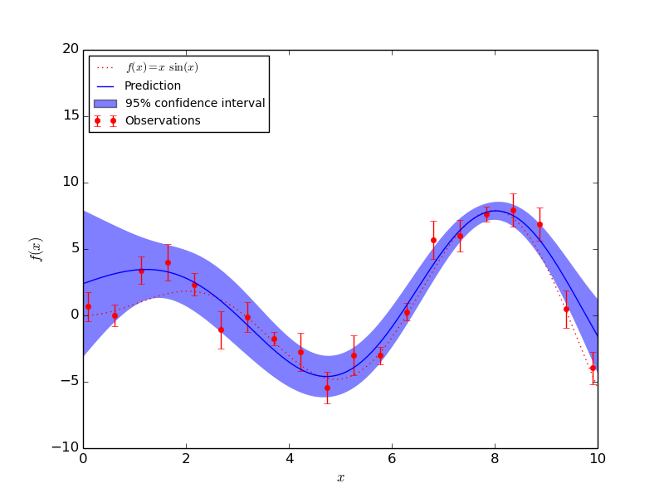
Kernel Gaussian Processes
http://scikit-learn.org/stable/auto_examples/gaussian_process/plot_gp_regression.html

Slide 19
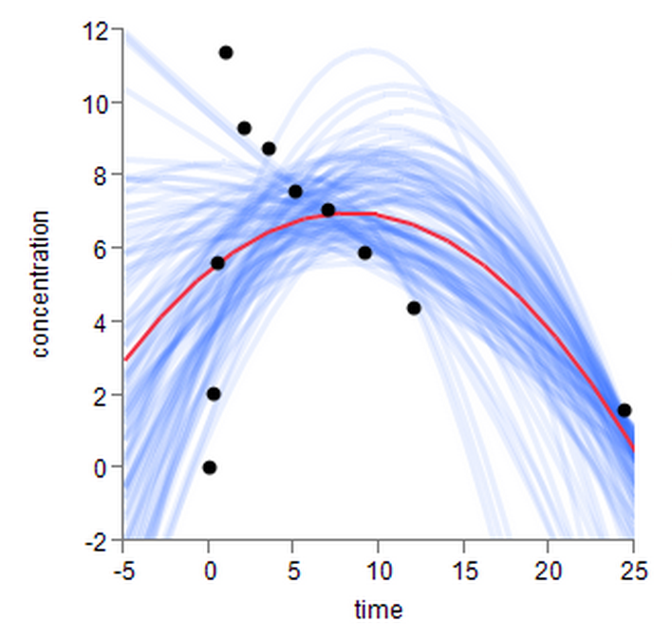
Bootstrap
y
x
http://blogs.sas.com/content/jmp/2012/12/04/visualizing-the-variability-of-a-curve-using-bootstrapping/

Slide 20
Summary
Kernel trick for generative models: When d >> N the covariance matrix X^{T}X is too large, we can use XX^{T} instead in many algorithms. This lends itself to “kernelization”:
Kernel PCA,
Kernel LDA,
Kernel ridge regression a.k.a. “Gaussian processes”.
Parameter estimation: From a data generating point of view, Maximum Likelihood (ML) makes sense as a parameter estimation paradigm:
The “classical” ways of estimating mean and covariance are ML estimators.
Regularization has also its equivalent in the data generating setting: the Maximum A Posteriori (MAP) framework.
Gaussian processes: For regression, Gaussian processes allow you to estimate P(Y|X), so compute error bars of predictions.

Slide 21







Thanks
Alexei (Alyosha) Efros
Brian Chu
Nihar B. Shah
Weicheng Kuo
Faraz Tavakoli
Deepak Pathak
Shaun Singh

Slide 22
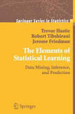
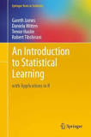



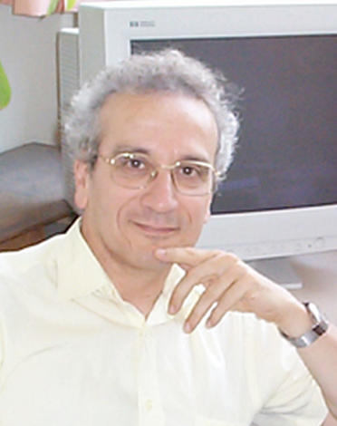
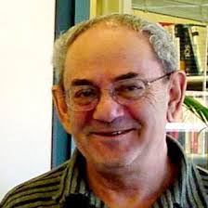







Thanks

Slide 23
Generative models
First part
of class
Today
P(X|Y)
Algorithm:
Centroid
w =Σ_{k} y^{k}x^{k} = X^{T}y
y^{k}∈{+1/N₁, -1/N₀}
w= μ^{[1]}– μ^{[0]}
LDA
Mixture models
Gaussian
processes
Algorithm:
w= Σ⁻¹(μ^{[1]}– μ^{[0]})
Σ = X^{T}X+λΙ, λ>0
w = Σ⁻¹ X^{T}y
y^{k}∈{+1/N₁, -1/N₀}
Naïve Bayes

Slide 24
Discriminative models f(x) = ( Σ_{k} α_{k} [Φ(x^{k}) ) • Φ(x) ]
First part
of class
P(Y|X)
w
k(x^{k}, x; θ)
Algorithm:
Hebb’s rule
w = Σ_{k=1:N} y^{k}x^{k}
w = X^{T}y
Parzen windows
α_{k =} y_{k}
Any k(x^{k}, x; θ)
θ fitted to R_{CV}
f(x)=Σ_{k} α_{k} k(x^{k}, x ; θ)
“Perceptrons”
α_{k} fitted to R_{train}
k(x^{k}, x) = x^{k} • x
No θ
f(x) = w • x
Kernel methods
α_{k} fitted to R_{train}
Any k(x^{k}, x; θ)
θ fitted to R_{CV}
f(x)=Σ_{k} α_{k} k(x^{k}, x ; θ)
Hebb’s method
α_{k =} y_{k}
k(x^{k}, x) = x^{k} • x
No θ
f(x) = w • x
Algorithms:
SVM
Logistic regression
Ridge regression
w = X⁺y = Σ⁻¹ X^{T}y

Slide 25

Structural Risk Minimization
First part
of class
Vapnik, 1974
With high probability (1-δ),
0<δ<<1
R[f] ≤ R_{emp}[f]+ ε(δ, C/N)
R_{gua}[f]
TEST
DATA
Ga, Guaranteed risk
Ga= Emp + ε(C/N)
–log P(D|f)~–log P(D|f) –log P(f)
ε, Function of Model Complexity C
Emp, empirical risk
Complexity/Capacity C
Negative log likelihood = Empirical risk R[f]
Negative log prior = Regularizer Ω[f]
Increasing complexity
Make nested subsets of models, increasing complexity/capacity:
S₁⊂ S₂ ⊂ … S_{N}
S₃
S₂
S₁

Slide 26

Model selection / hyper-parameter search
First part
of class
DATA SCIENTIST
TEST
DATA
Validation
set
Training
set

Slide 27


Your turn to play…
First part
of class
P(X, Y)
TRAINING
DATA
ORACLE
DATA SCIENTIST
ORACLE
Validation
set
Training
set
THE
BOSS
I.I.D. examples (x₁, y₁), (x₂, y₂), …
TEST
DATA
THE ML “STAFF”

Slide 28

Drive safely!
First part
of class
Keep C/N (or d_{eff}/N) under control

Slide 29

Come to my office hours… Wed 2:30-4:30 Soda 329
Next time: Prof. Efros!

